Slide 1
Having Fun with T-SQL Part -3
Md. Khairul Alam MCTS, MCPD, CSM
Software Engineer, AML
DataSoft Systems Bangladesh Limited

Slide 2

Joins, Subqueries, and CTEs
Novice To Ninja

Slide 3
Relational databases
Relational databases, by their nature, segment data into several narrow, but long, tables.
Seldom does looking at a single table provide meaningful data. Therefore, merging data from multiple tables is an important task for SQL developers.
The theory behind merging data sets is relational algebra, as defined by E. F. Codd in 1970.
Ref: SQL Server Bible.

Slide 4
Relational algebra
Relational algebra consists of eight relational operators:
Restrict: Returns the rows that meet a certain criterion
Project: Returns selected columns, or calculated data, from a data set
Product: Relational multiplication that returns all possible combinations of data between two data sets
Union: Relational addition and subtraction that merges two tables vertically by stacking one table above another table and lining up the columns

Slide 5
Relational algebra
Intersection: Returns the rows common to two data sets
Difference: Returns the rows unique to one data set
Join: Returns the horizontal merger of two tables, matching up rows based on common data
Divide: The inverse of relational multiplication, returns rows in one data set that match every row in a corresponding data set.

Slide 6
Relational algebra
In addition, as a method to accomplish relational algebra, SQL has implemented the following:
Subqueries: Similar to a join but more flexible; the results of the subquery are used in place of an expression, list, or data set within an outer query.
In the formal language of relational algebra:
A table, or data set, is a relation or entity.
A row is a tuple.
A column is an attribute.

Slide 7
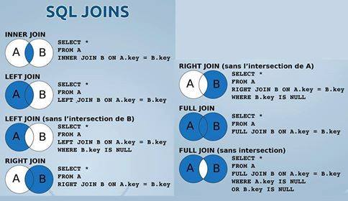
Using Joins

Slide 8
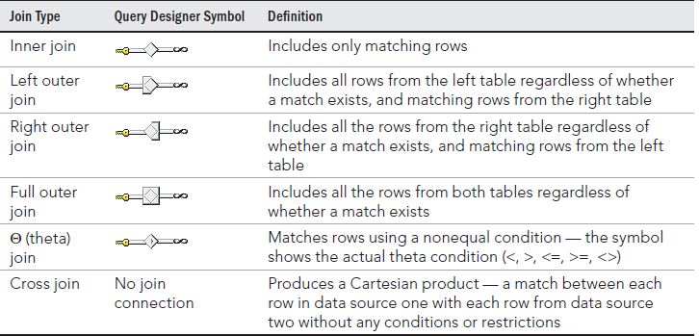
Using Joins

Slide 9
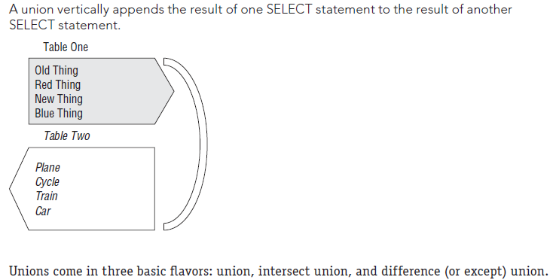
Unions
UNION
UNION ALL
Intersection Union
Difference Union/Except

Slide 10
Subqueries
Simple subquery: The simple subquery can be a standalone query and can run by itself. It is executed once, with the result passed to the outer query. Simple subqueries are constructed as normal SELECT queries and placed within parentheses.
Common table expression (CTE): CTEs are a syntactical variation of the simple subquery, similar to a view, which defines the subquery at the beginning of the query using the WITH command. The CTE can then be accessed multiple times within the main query as if it were a view or derived table.
Correlated subquery: This is similar to a simple subquery except that it references at least one column in the outer query, so it cannot run independently. Conceptually, the outer query runs first, and the correlated subquery runs once for every row in the outer query. Physically, the Query Optimizer might generate amore efficient plan.

Slide 11
Best Practice
When coding outer joins, always order your data sources so that you can write left outer joins. Don’t use right outer joins, and never mix left outer joins and right outer joins.
Use a join to pull data from two data sources that can be filtered or manipulated as a whole after the join. If the data must be manipulated prior to the join, try a derived table subquery.

Slide 12


